Slide 1





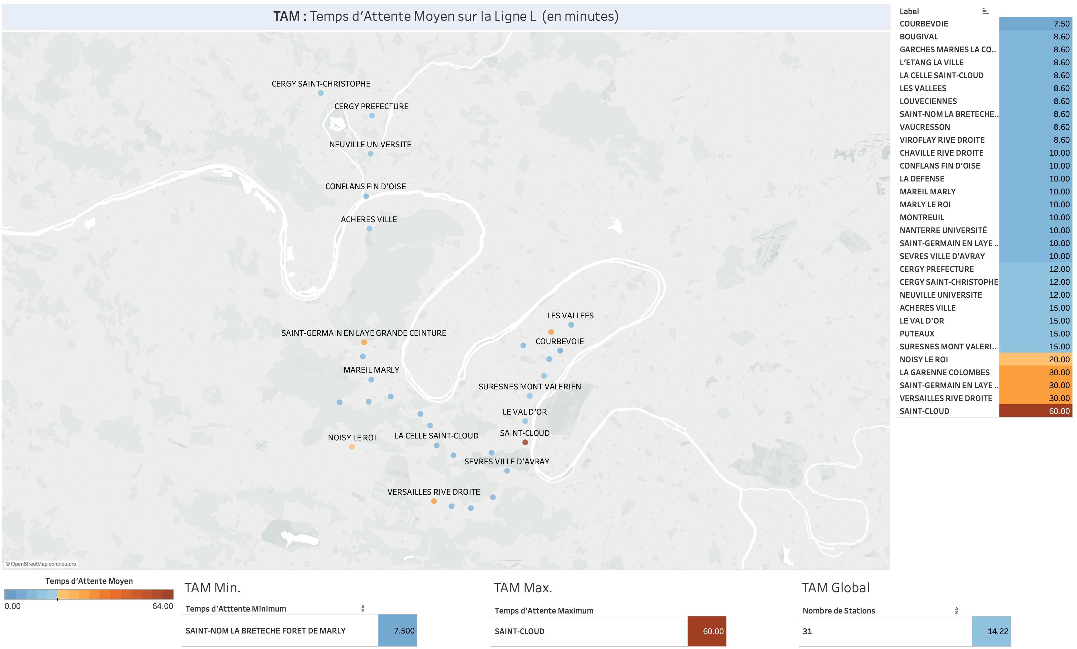
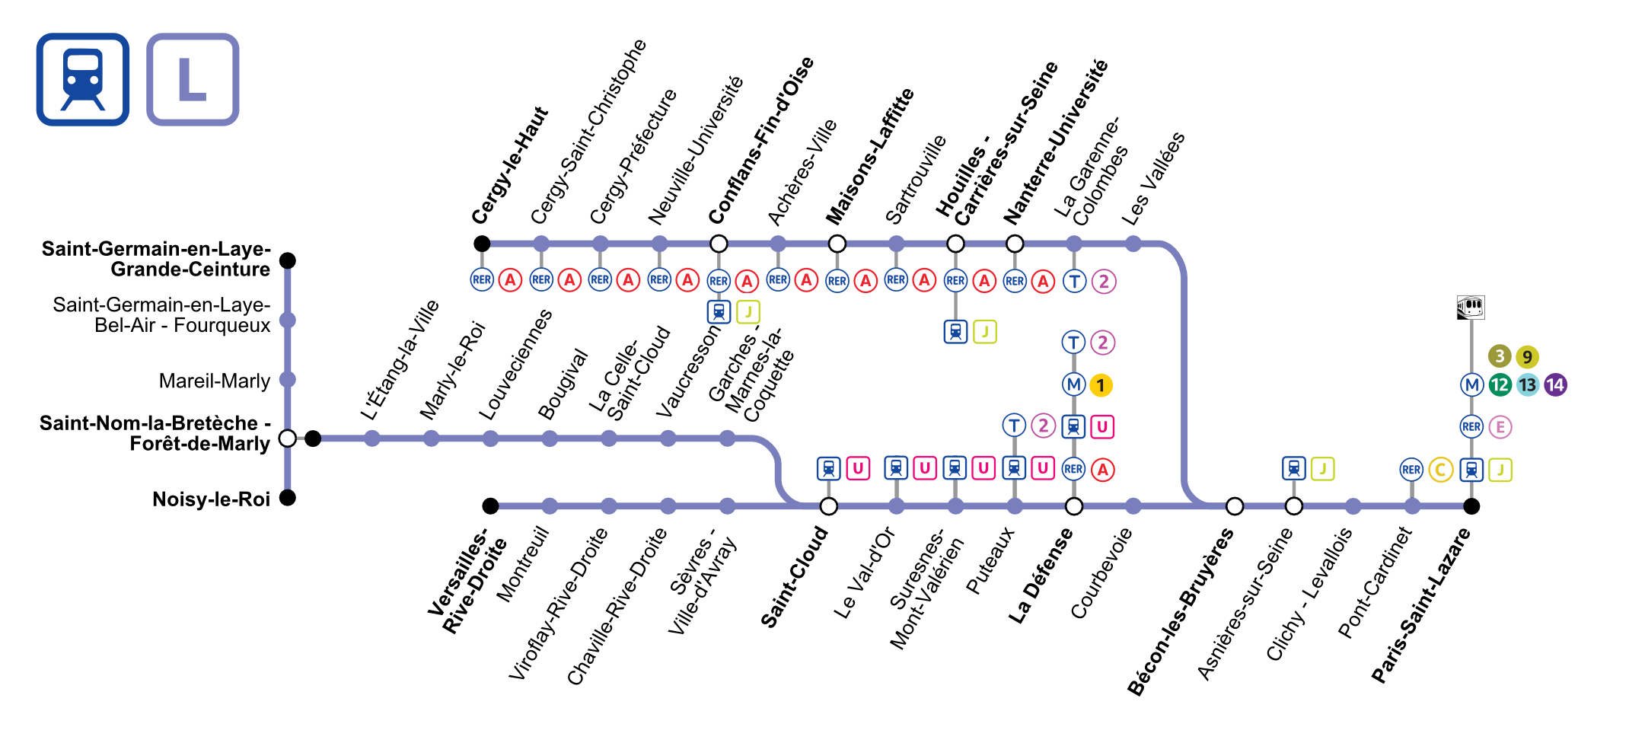
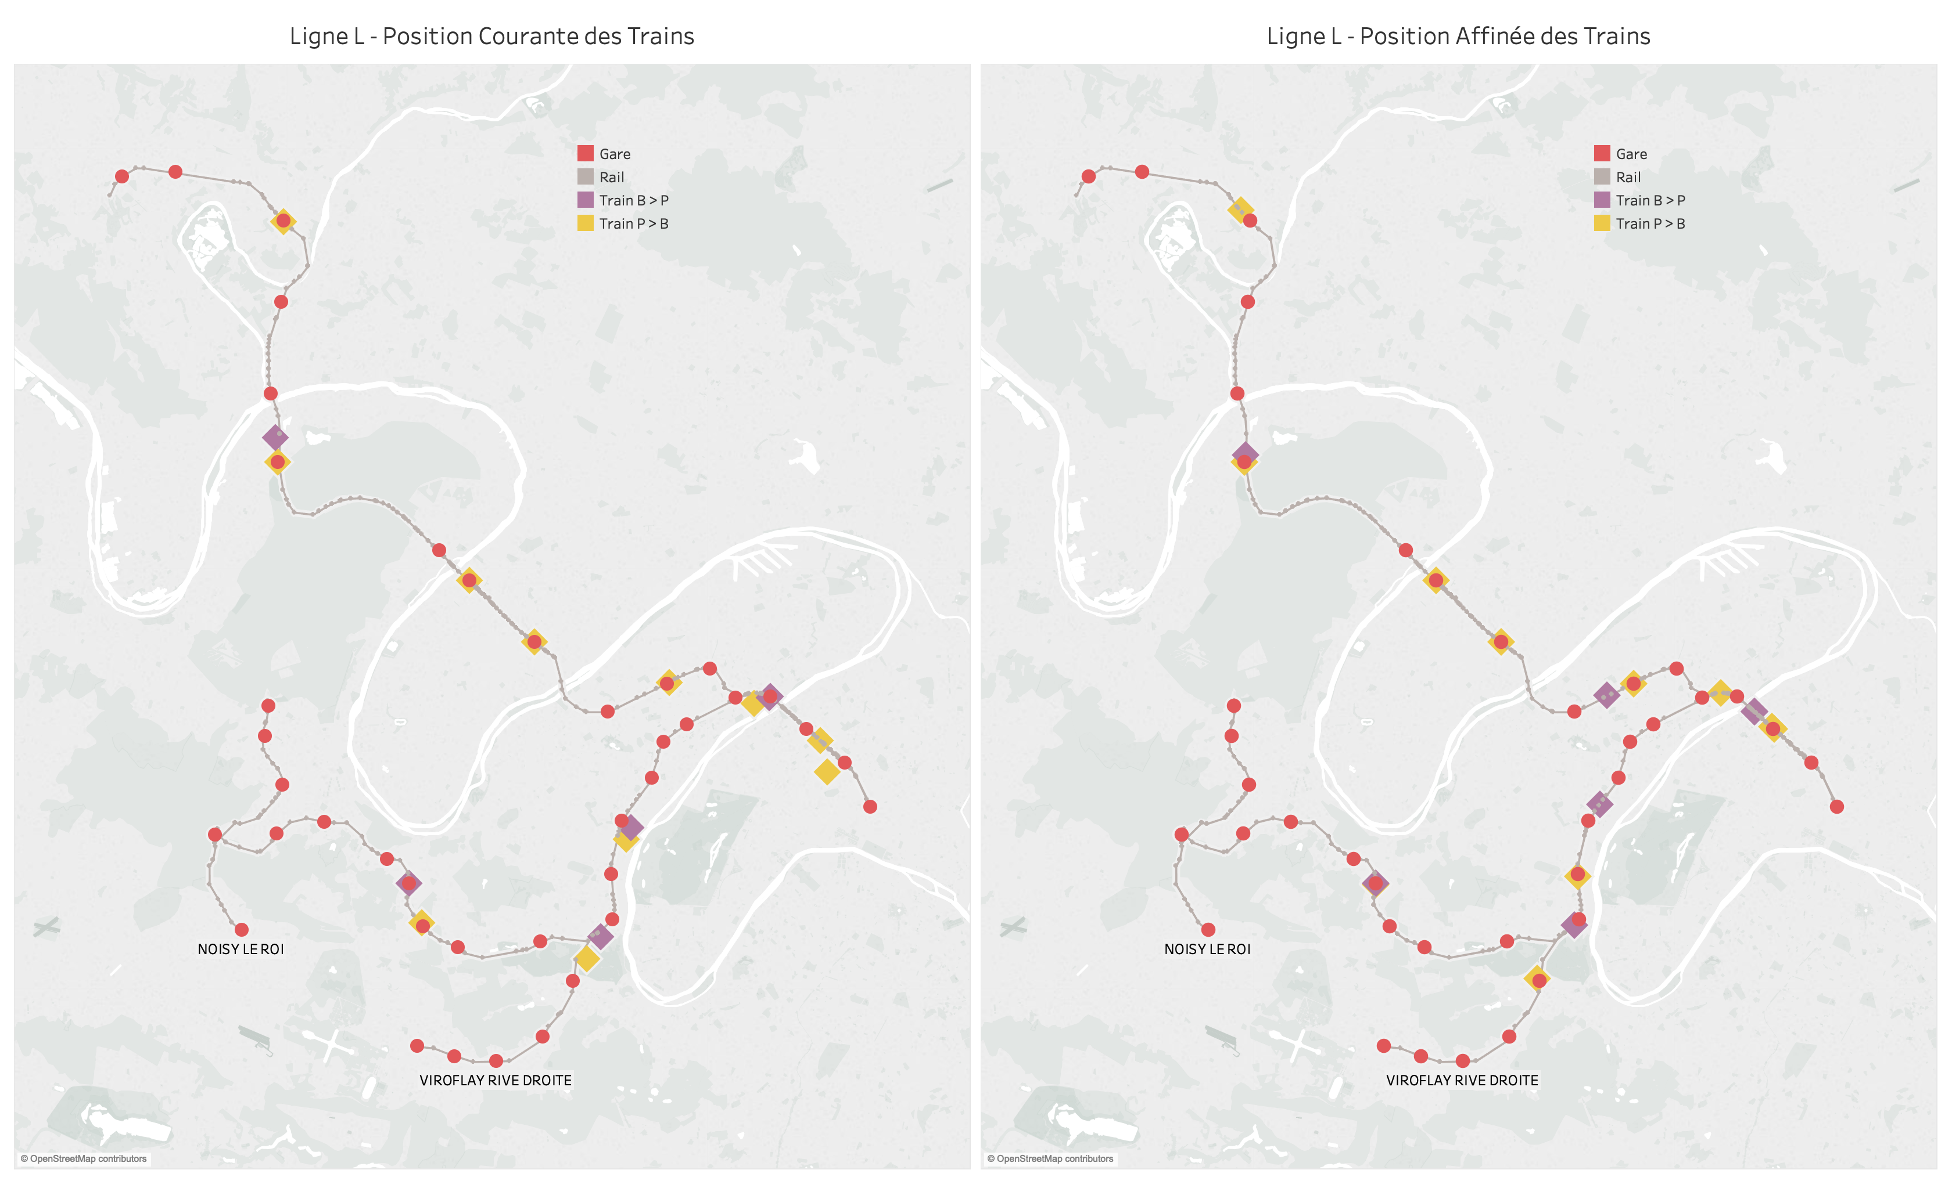



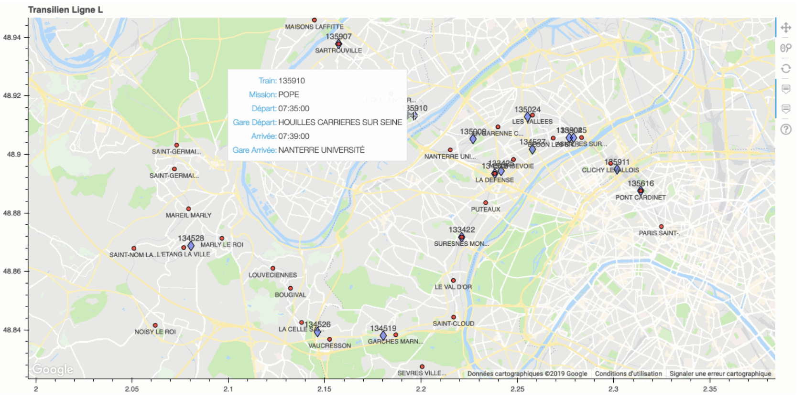
SNCF
OPEN DATA
PRODUCER
CONSUMER
TABLEAU
API REST
XML
JSON
Sources
de données
Connecteur
ForEachBatch
Last Hour
Awaiting Time
Ligne L
TempView
stations_data
min_awt
max_awt
ordered_awt
ForEachBatch
Trains
Progression
Pull
Push
Topic :
Transilien-02
Link
Serveur Thrift
TempView
trains_progression
GOOGLE
MAP
BOKEH
TRAINS TRACKER
API REST

